Slide 1



UChicago ICPC
Practices Saturday 1-3pm in CSIL
Join our Discord!
bit.ly/46bEXjO
…and our Listhost!
bit.ly/3tdfsQE

Slide 2

Bowling Social

Slide 3
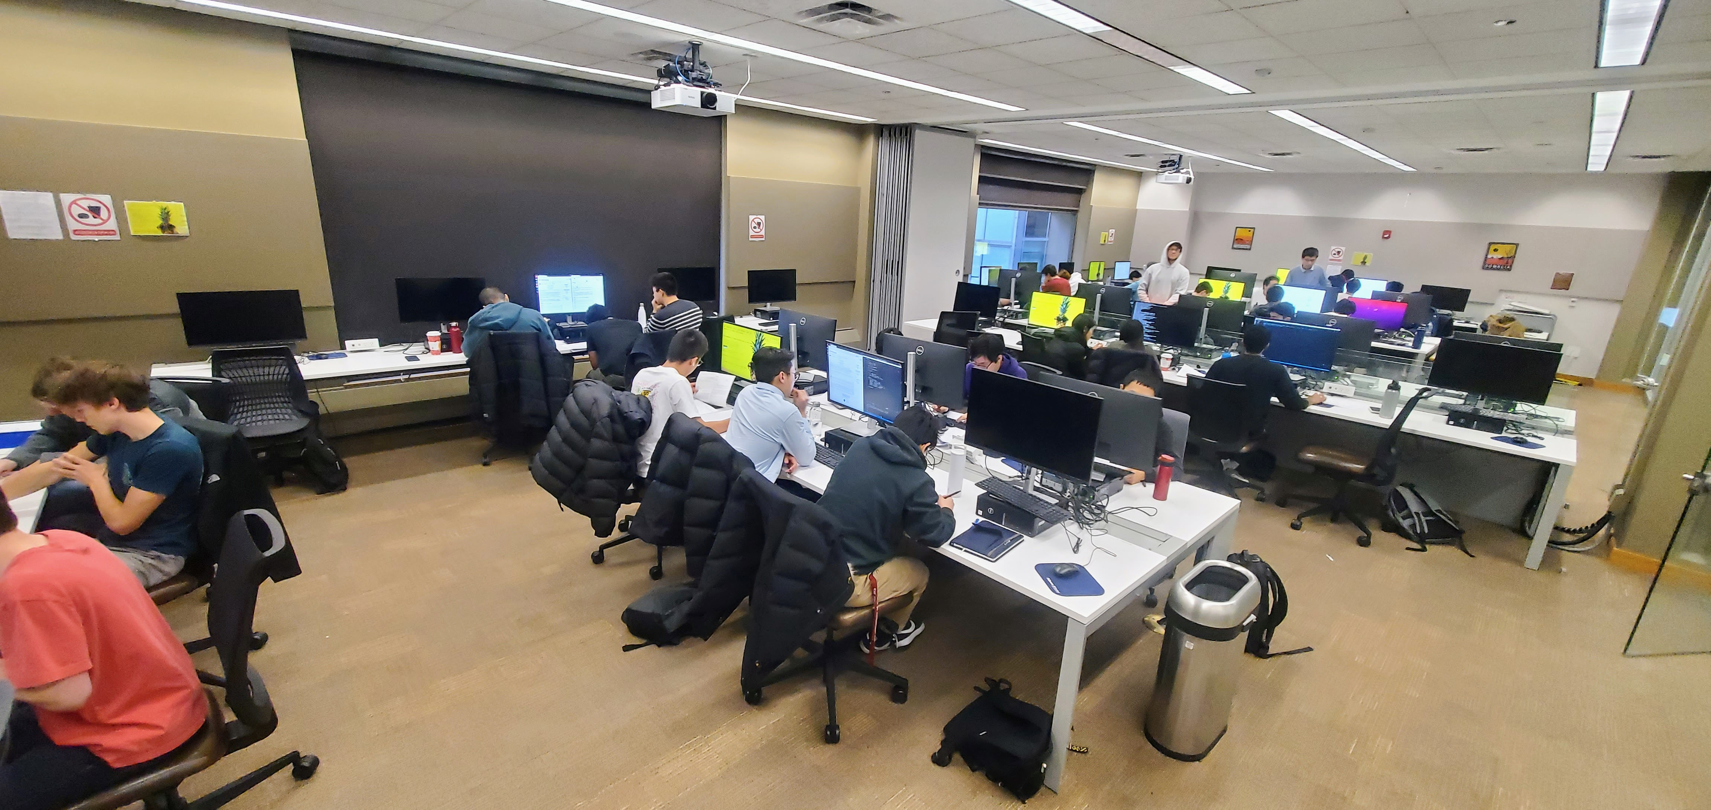
Tryouts

Slide 4
Example problem
Black and White is a Chinese children’s game played in rounds. During each round, the children who are playing all put their hands in either face-up (“white”) or face-down (“black”). If all the children but one make the same choice, then the “odd one out” sits out for the rest of the game. Play continues until there are only two children left.
Given an integer n representing the number of children, and the probability for each child that they will put their hand face-up, output the expected number of rounds that such a game will last.

Slide 5
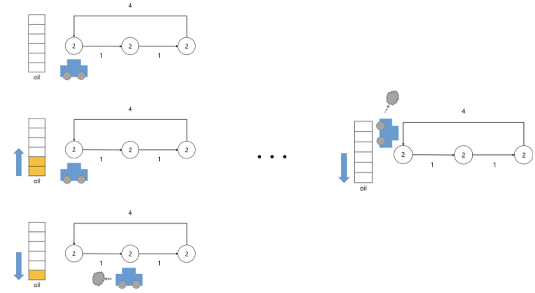
Highway Track
There is a circular highway track in Jack's hometown. There are 𝑁 gas stations in this track, and the stations are numbered from 1 to 𝑁. One day, Jack decided to drive one lab around this track, starting from a particular gas station. But his hometown is a bit strange, so the amount of gas that can be purchased at each gas station is fixed. Moreover, the sum of them is exactly equal to the amount of gas needed to drive one cycle around the track. Jack initially has no gas at all. Therefore, if he chooses a bad gas station, his car may run out of gas before he can arrive to another gas station.
Write a program to find the number of gas stations, that if Jack starts from the station, he can safely drive around the track.

Slide 6
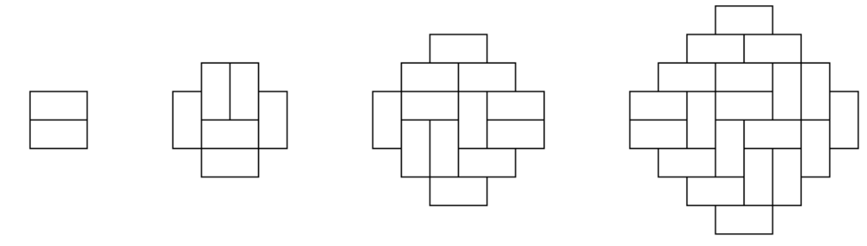
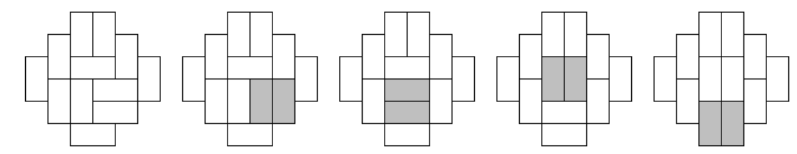
Diamond Puzzle
Ziyi found some ancient diamond-shaped symbols composed of 1x2 bricks.
Noticing that some bricks are horizontal and some are vertical, Ziyi felt uncomfortable and decided to turn all bricks to vertical. Ziyi cannot lift a brick with one hand, but he can lift two bricks with two hands. Therefore, the only thing he can do is to choose any 2x2 square composed of two bricks and rotate it 90 degrees.
How many rotations are needed to align all the bricks vertically?

Slide 7
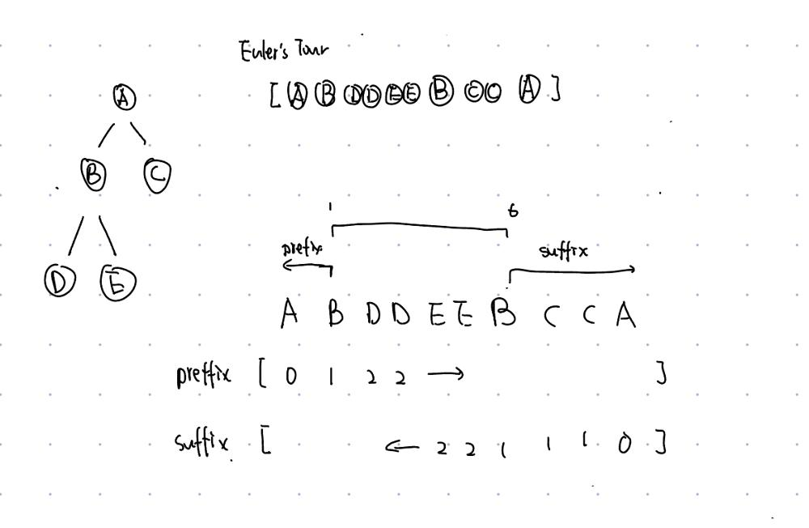
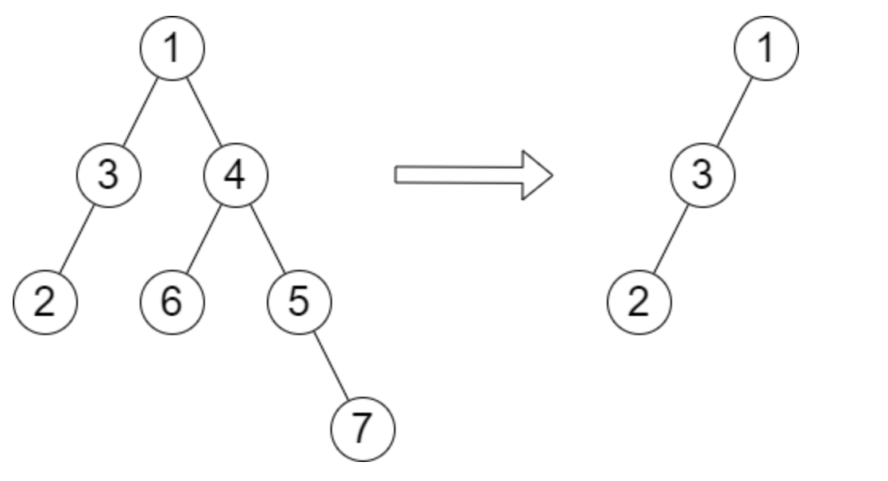
Height of Binary Tree After Subtree Removal
Question: Input: root = [1,3,4,2,null,6,5,null,null,null,null,null,7], queries = [4]
Output: [2] Explanation: The diagram above shows the tree after removing the subtree rooted at node with value 4. The height of the tree is 2 (The path 1 -> 3 -> 2).
Solution:

